Slide 1
Landing Page
Home

Slide 2
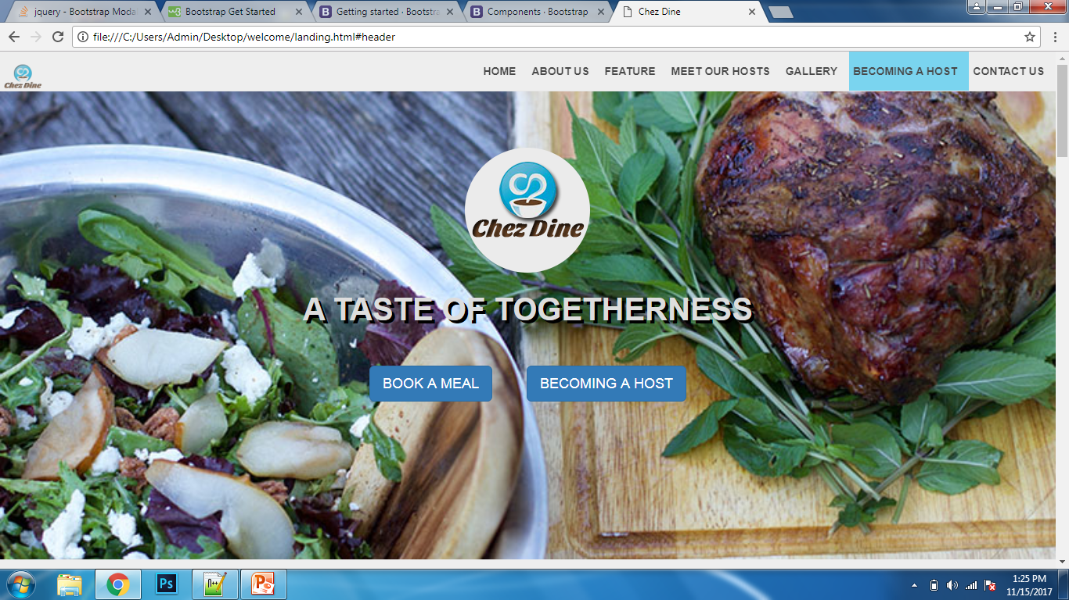

Slide 3
Landing page
About us

Slide 4
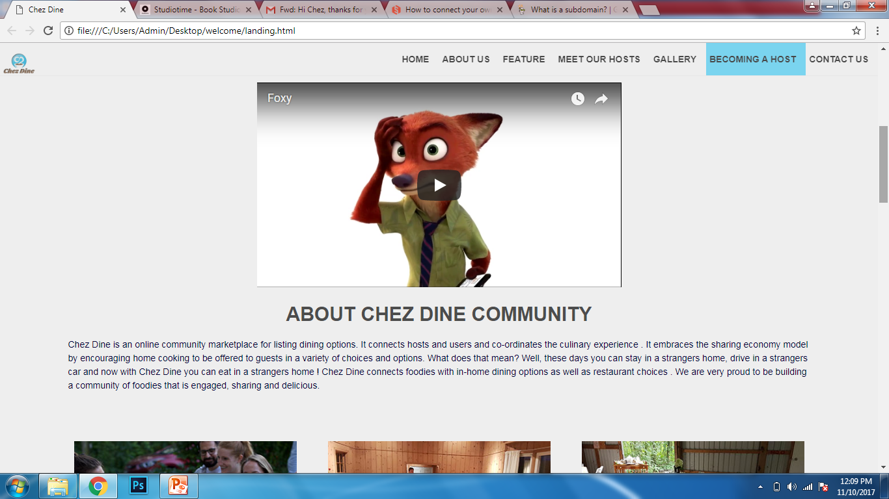

Slide 5
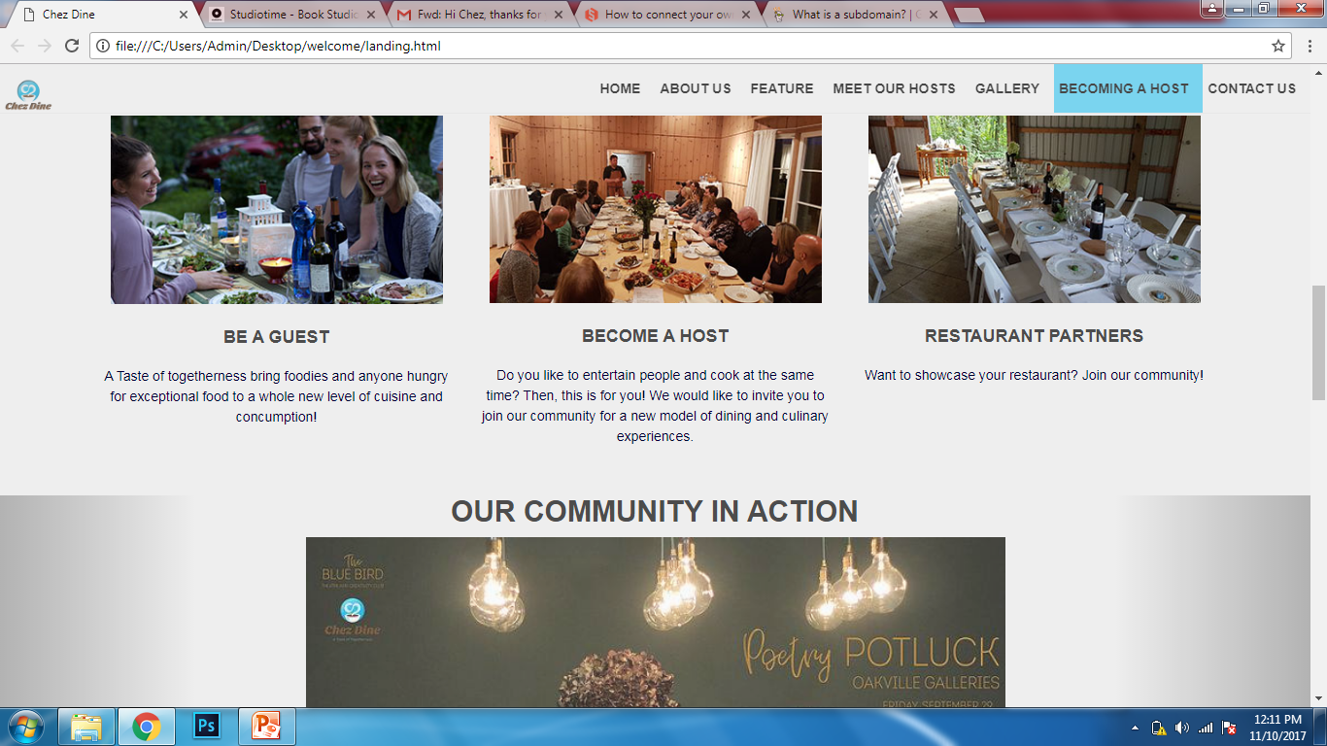

Slide 6
Landing page
Meet our hosts

Slide 7
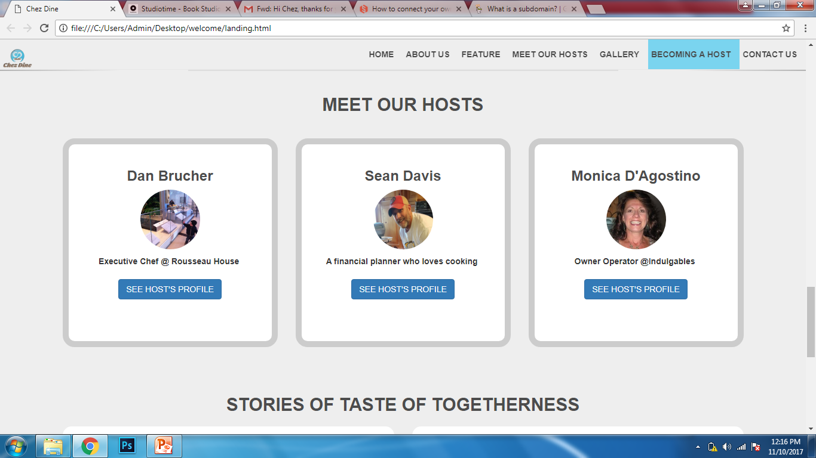

Slide 8
Landing page
Testimonials or reviews

Slide 9
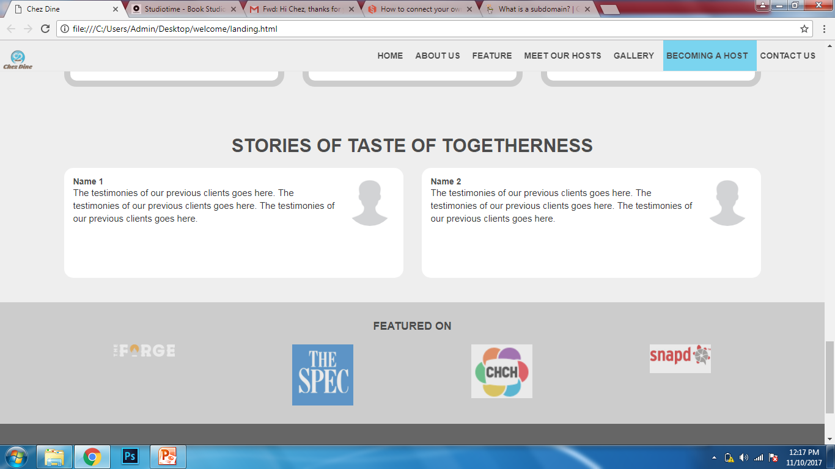

Slide 10
Gallery page

Slide 11
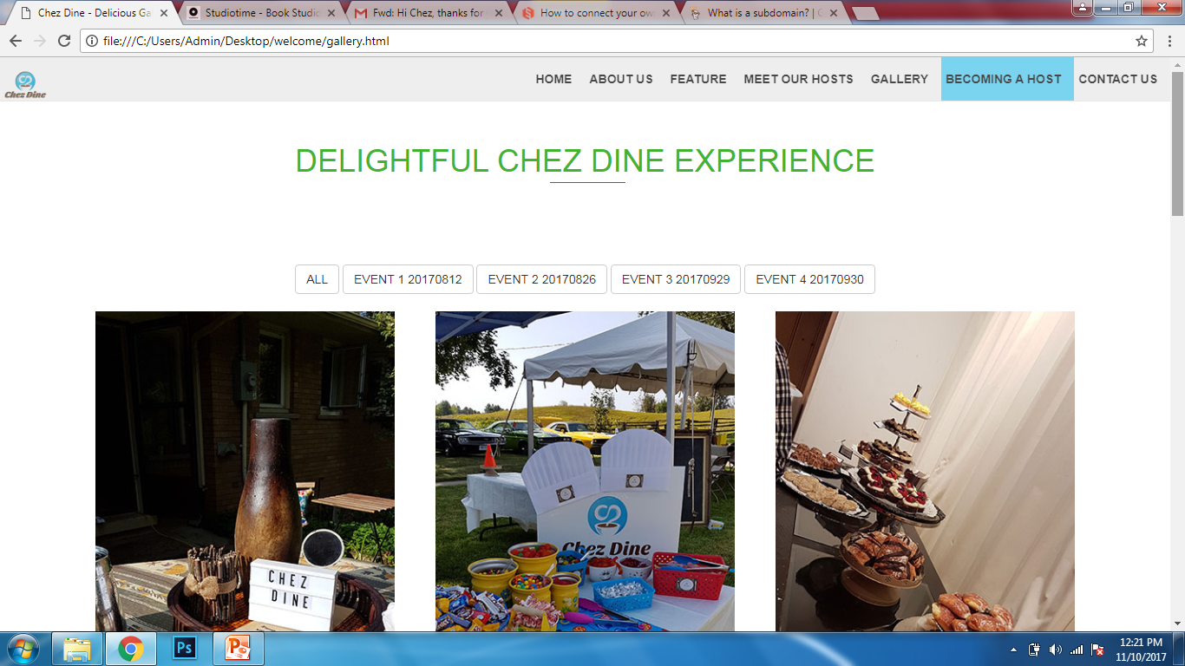
Please pick some photos for the gallery.

Slide 12
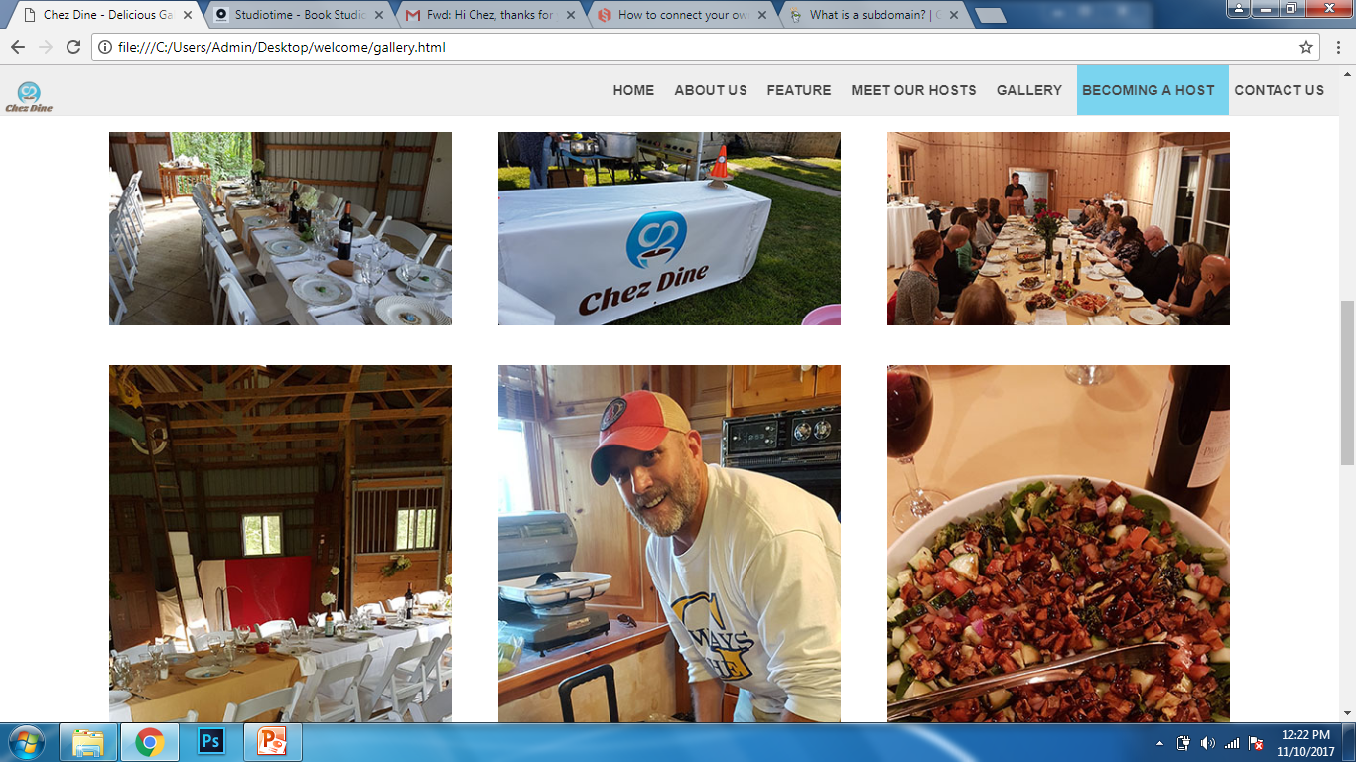

Slide 13
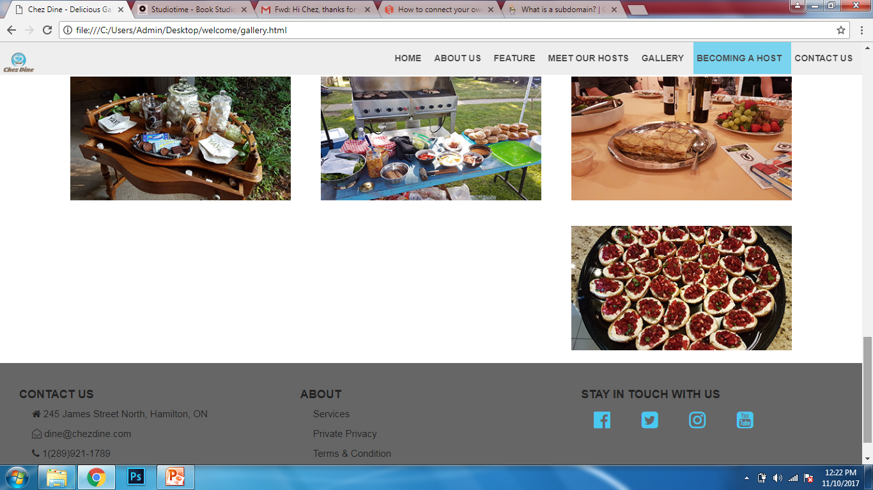

Slide 14
Service page

Slide 15
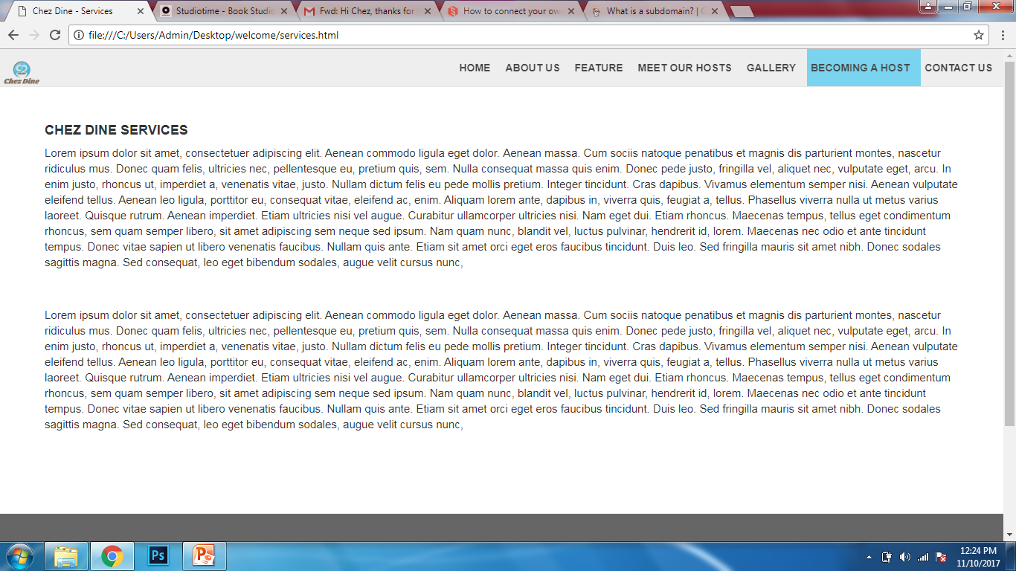
Jen, do you prefer to explain our service in text or with pictures?

Slide 16
Privacy and Condition page

Slide 17
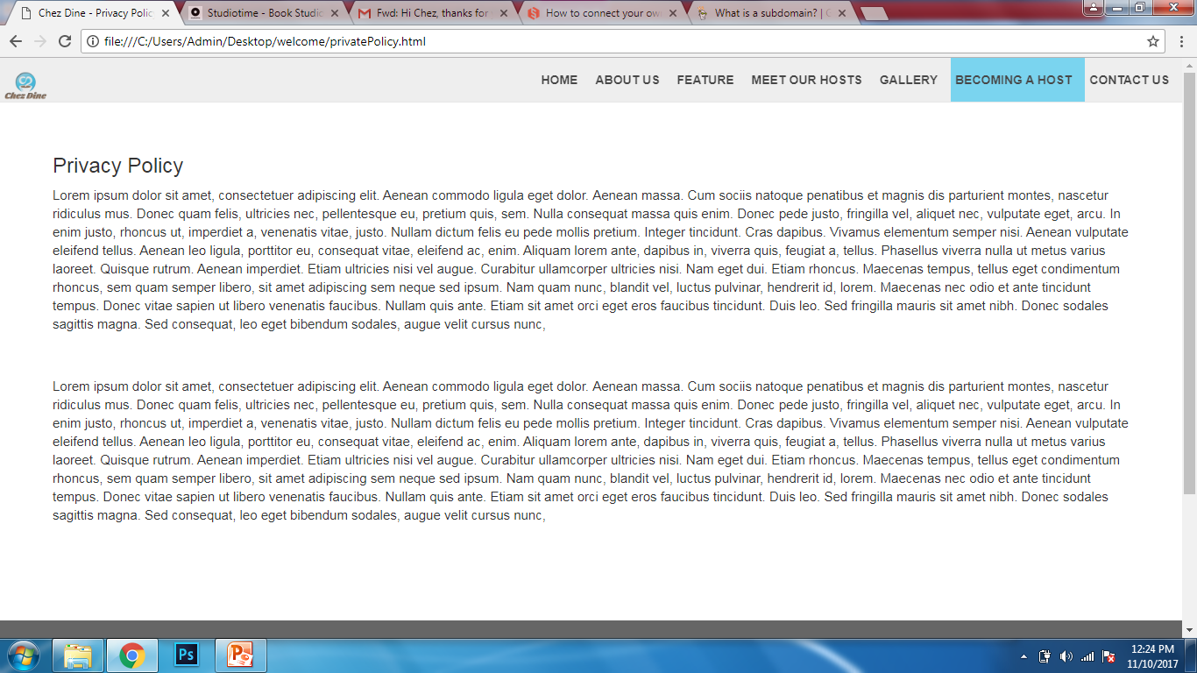

Slide 18
Terms and Conditions page

Slide 19
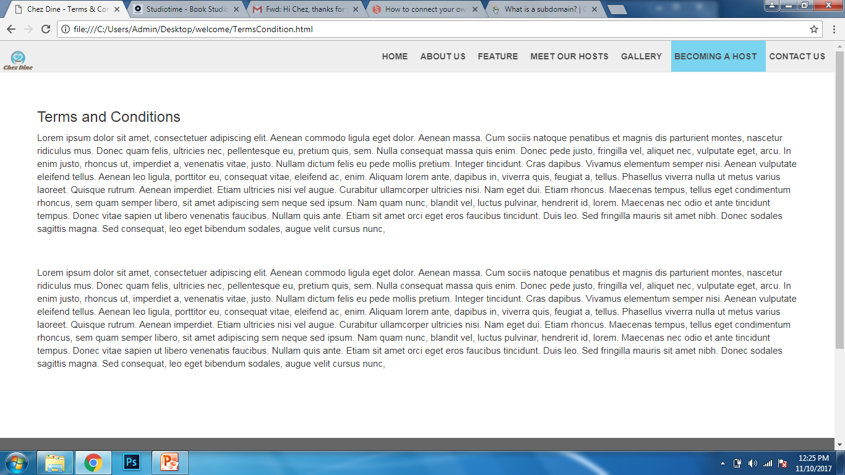

Slide 20
Popup box
For redirecting people who are interested to register in our community to the correct page

Slide 21
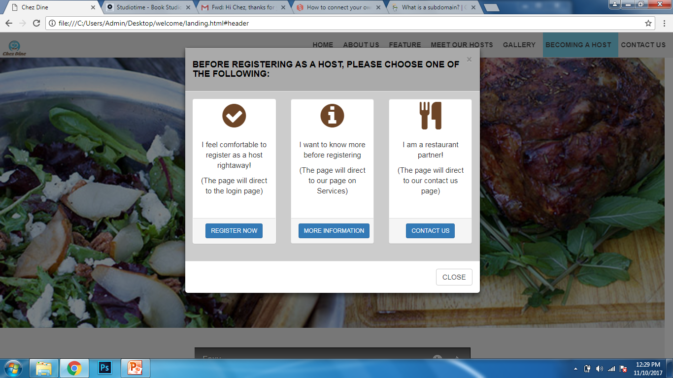

Slide 22
Host Profile page

Slide 23
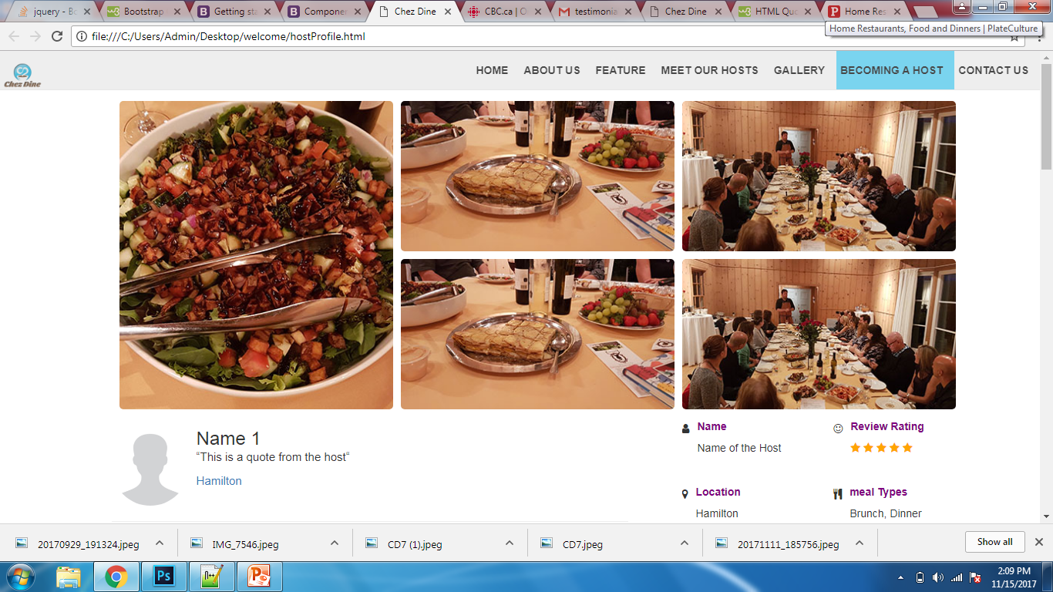
Until now, each host will have six featured pictures. I hope to add more later with some effects.
This column now contains Name, Review star rating, location, meal types, language and number of guests.

Slide 24
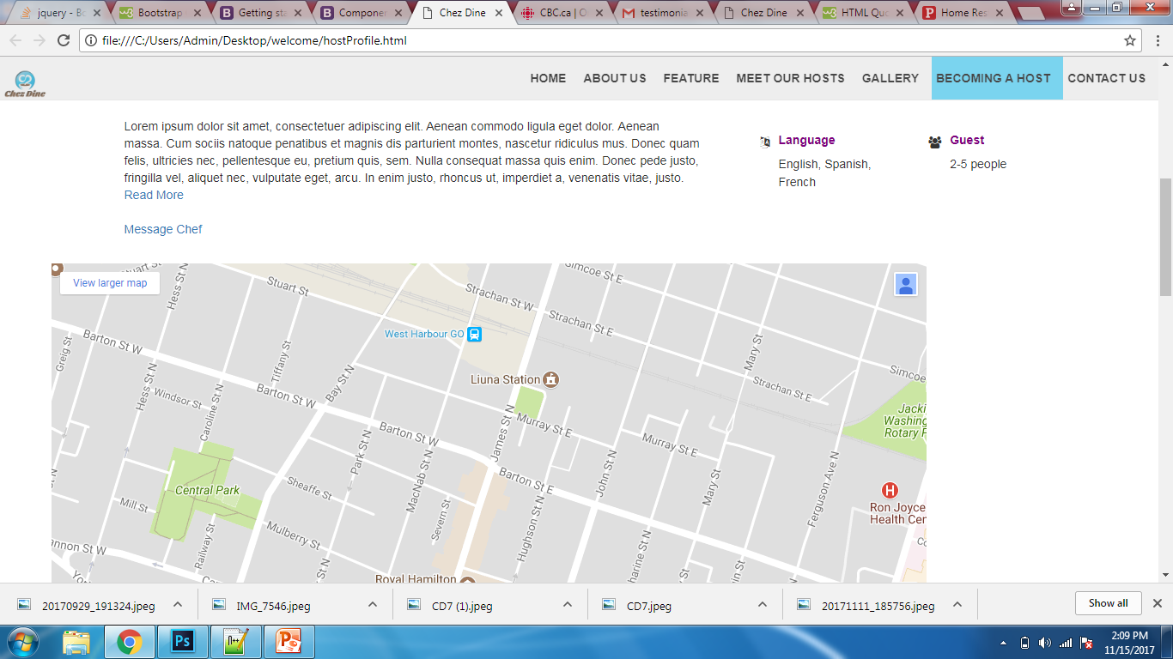

Slide 25
